Slide 1

Women in Business
By Noelle Brooks, Lani Jones, and Jennifer Nolos
Entity Virtual Academy/ Woz U

Slide 2

Who We Are: Lani Jones
Public Relations, Bachelor’s Degree, University of Central Oklahoma (UCO)
Data Science, Entity Virtual Academy/ Woz U
Graphic Designer and Publishing Assistant at UCO
Goal: entry level data analyst for fashion related company in London, England

Slide 3

Who We Are: Jennifer Nolos
Chemical Engineering, Bachelor’s Degree, Syracuse University
Data Science, Entity Virtual Academy/ Woz U
Associate Banker for JP Morgan Chase
Goal: land an entry-level data analyst position with JPMC

Slide 4

Who We Are: Noelle Brooks
Mass Communication – Print Concentration, Bachelor’s Degree, Georgia College & State University
Executive MBA, Masters Degree, Wesleyan College
Data Science, Entity Virtual Academy/Woz U
Marketing Coordinator for Choice Premiums
Goal: Get an entry level data analyst job with a start-up or hire myself as co-founder of a tech start-up

Slide 5
About the Project
Our Data Is From
US Census Bureau
Women’s Business Enterprise National Council (WBENC)
Project Background
As women professionals, we want to understand what success for women looks like in the marketplaces.
One want to analyze this is through the lens of women entrepreneurs

Slide 6
Initial Goals For The Project
Analyze remote work in women owned businesses
Connection between remote work and revenue
Connection between remote work and employee satisfaction
Top industries of women owned remote/partially remote businesses
Comparison between remote/partially remote businesses vs. non-remote

Slide 7


Slide 8
Goals For The Project
Sales growth for women owned businesses vs men owned businesses
Factors that contribute to successful women owned businesses
Employee growth rate for women owned businesses
Top industries for women entrepreneurs
Connection between race, ethnicity, and gender as it relates to businesses

Slide 9
Methods & Tools Used
Researched datasets with large samples and multiple variables
Explored reliable databases for historical data
Reviewed directories for real time data
Wrangled & assessed data with Python, R, & Tableau
Analyses focused on finding relationships between variables
Statistical formulas to assess
Trello for project management

Slide 10
Analysis
Examined connections between race, ethnicity, gender, and sales
Examine connections between race, ethnicity, gender, and industry
Reviewed average sales from 2018-2020 for men and women
Reviewed growth rate for men and women from 2018-2020
Assessed top industries for female-owned businesses

Slide 11
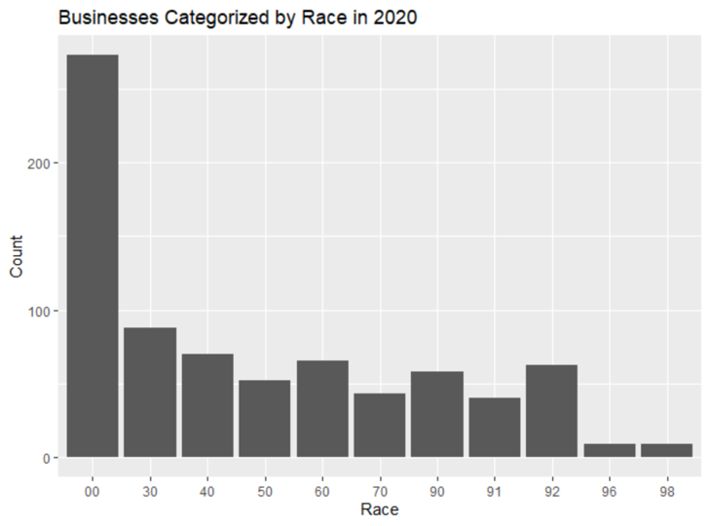
Must ignore the first value “00” since it accounts for the total of all races.
Majority of businesses owners were white, Caucasian
Second dominating race were black, African-American owners

Slide 12
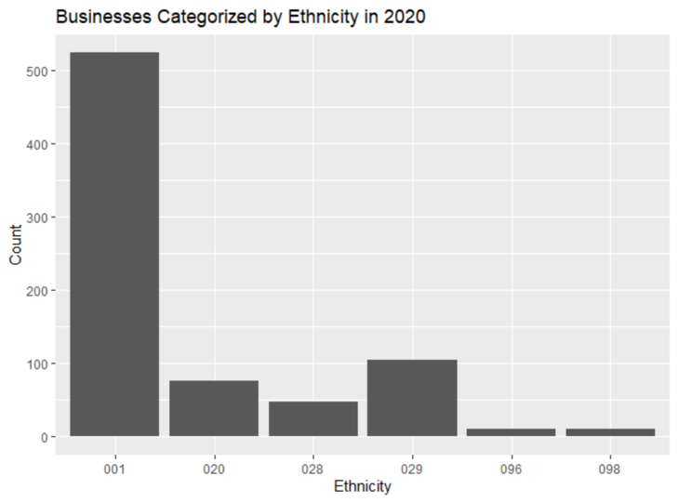
Must ignore the first value “001” since it accounts for the total of all ethnicities.
Majority of businesses owners’ ethnicity were non-Hispanic
While in second, were business owners that were Hispanic

Slide 13
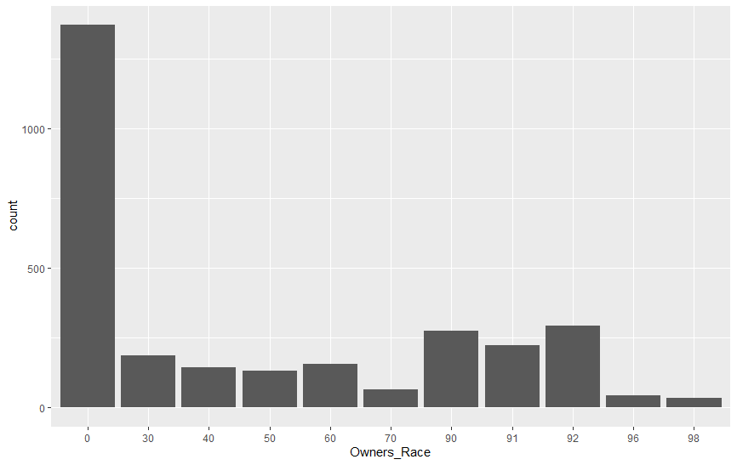
Businesses Categorized by Race 2019
Must ignore the first value “0” since it accounts for the total of all races.
Majority of businesses owners were white, Caucasian
Second dominating race were black, African-American

Slide 14
Businesses Categorized By Ethnicity 2019
Must ignore the first value “0” since it accounts for the total of all ethnicities.
Majority of businesses owners’ ethnicity were non-Hispanic
While in second, were business owners that were Hispanic

Slide 15
Businesses Categorized by Race 2018
Must ignore the first value “0” since it accounts for the total of all races.
Majority of businesses owners were white, Caucasian
Second dominating race were black, African-American

Slide 16
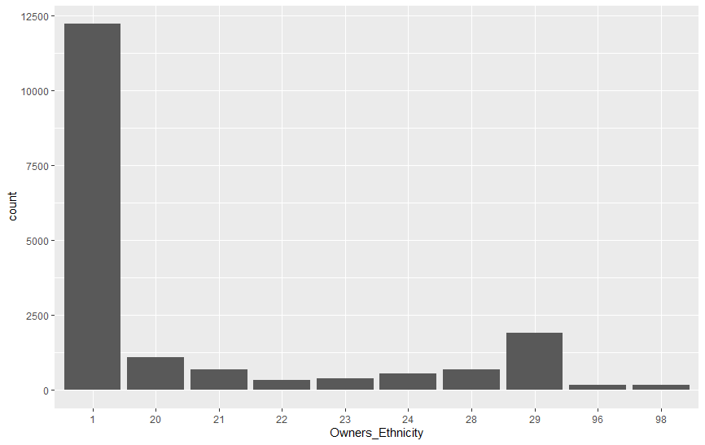
Businesses Categorized By Ethnicities 2018
Must ignore the first value “1” since it accounts for the total of all ethnicities.
Majority of businesses owners’ ethnicity were non-Hispanic
While in second, were business owners that were Hispanic

Slide 17
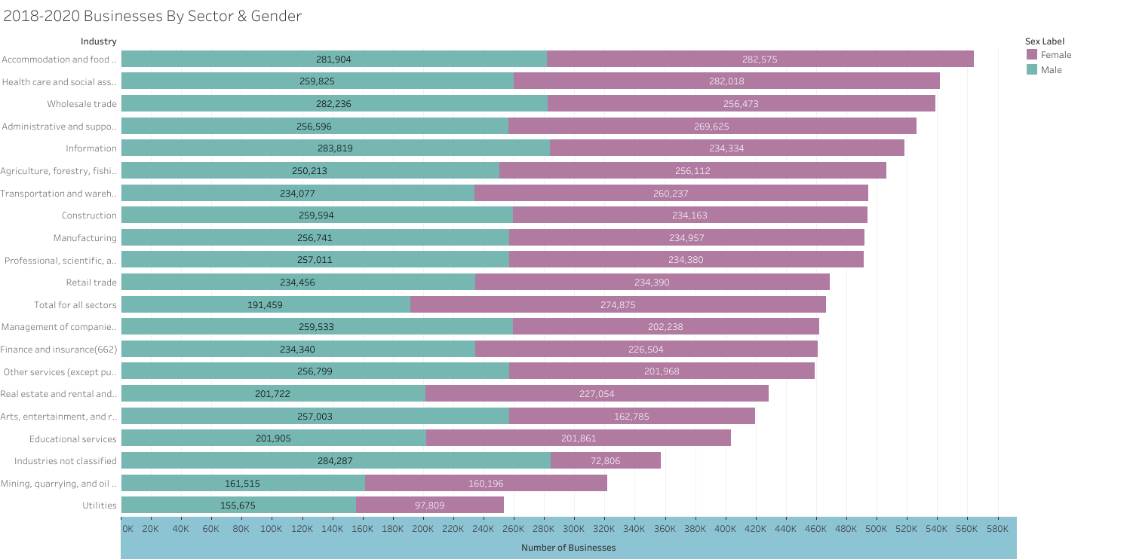

Slide 18
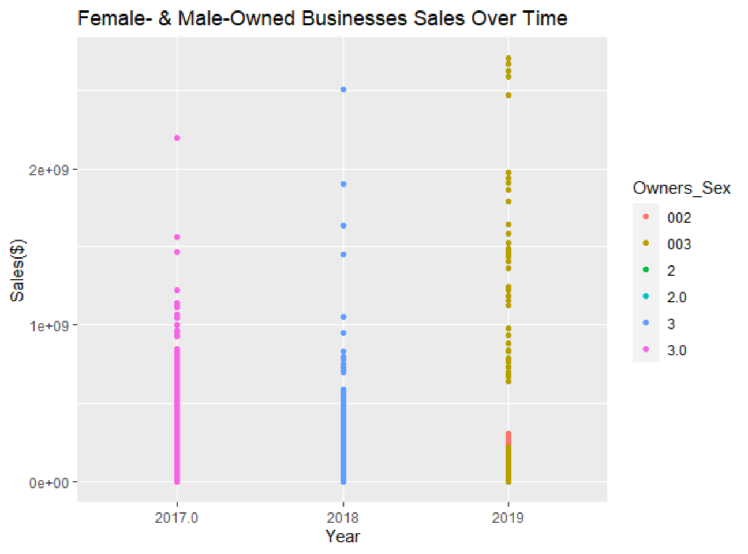
Datapoints are concentrated between each year
Shows a slight positive, upward trend
Growth rate for male owned businesses: 14.8%
Growth rate for female owned businesses: 13.08%

Slide 19
Results Summary
Top 5 industry sectors in 2020:
1. Professional, Scientific, and Technical Services
2. Health Care and Social Assistance
3. Accommodations and Food Services
4. Manufacturing
5. Transportation and Warehousing
Top 5 industry sectors in 2019:
1. Professional, scientific, and Technical Services
2. Manufacturing
3. Healthcare and Social Assistance
4. Retail Trade
5. Administrative and Support and Waste Management and Remediation Services

Slide 20
Results Summary Con’t.
Top 5 Industry Sectors in 2018:
1. Administrative and support and Waste Management and Remediation Services
2. Health Care and Social Assistance
3. Professional/Scientific/Technical Services
4. Accommodation and Food Services
5. Retail Trade
Top 3 Industry Sectors Over Past Three Years
1. Health Care And Social Assistance
2. Professional, Scientific, and Technical Services
3. Administrative and Support and Waste Management and Remediation Services

Slide 21
Summary
No significant relationship between race, ethnicity, gender, and sales
No significant relationship between race, ethnicity, gender, and industry
Growth rates for male-owned and female-owned businesses were similar with a difference of 1.74%
While average sales for female-owned businesses compared to male-owned, there are also fewer female-owned businesses: (though they account for 42% of all businesses in the U.S.)
Top industries for women remained relatively the same except for transportation and warehousing in 2020

Slide 22
Conclusions
Gender, race, and ethnicity are not a predictors for success, particularly with the earning potential
Female-owned businesses are emerging in sector previously atypical for women (such as construction and transportation)
Barriers to women owning businesses do not appear to be institutionalized, and may be related to other factors such as risk aversion and childcare

Slide 23
Lessons Learned
Pivoting sooner when encountering challenges
National scale large and too ambitious: regional or state level would have been better
Better understanding of extracting API data from sources such as YouTube
Started with basic statistical analysis before attempting more advanced statistical analysis

Slide 24
Questions

Slide 25
Did any of the results surprise you?
Lack of evidence for an inherent connection between race, ethnicity, and sales
Number of women-owned businesses in manufacturing, construction, and waste management
Lack of evidence for an inherent connection between gender and sales

Slide 26
Did we find any institutional biases during our research?
Did not find any institutional biases
Women did not take advantage of financial opportunities as often as men
Limiting business growth for women and/or entrances into other markets

Slide 27
Did this project change how you felt about owning your own businesses?
Changed how I feel about owning my own business for the better
Increased confidence that I can be as successful as my male counterparts
Encouraged seizing opportunities early and often

Slide 28
Follow our GitHub as we continue our research. Thank you!

Slide 29
Bibliography
Small Business Index | MetLife & US Chamber of Commerce
Who Started Businesses During the Pandemic? A Survey of Women Starting Businesses During COVID | Gusto
Women-Owned Businesses: Statistics and Overview (2021) - Fundera Ledger
Businesses owned by women and minorities have grown. Will COVID-19 undo that?
U.S. Census Bureau: Annual Business Surveys (2018-2020)

